Slide 1

Discrete Structures
S. Y. B. Tech (CSE)
SCHOOL OF COMPUTER ENGINEERING AND TECHNOLOGY

Slide 2
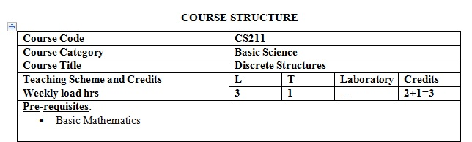
Discrete Structures

Slide 3

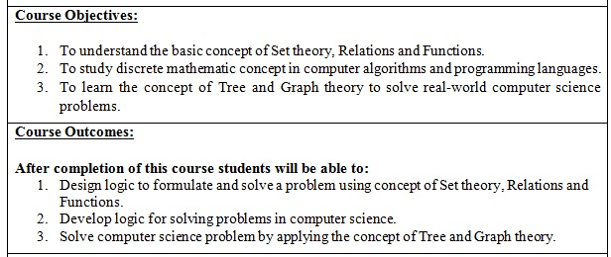
Course Outcomes

Slide 4
Resources Used
Text Books:
Kenneth H. Rosen, ―Discrete Mathematics and its Applications, Tata McGraw-Hill, ISBN 978-0-07-288008-3, 7th Edition.
C. L. Liu, ―Elements of Discrete Mathematics, TMH, ISBN 10:0-07-066913-9.
Reference Books:
Bernard Kolman, Robert C. Busby and Sharon Ross, ―Discrete Mathematical Structures, Prentice-Hall of India /Pearson, ISBN: 0132078457, 9780132078450.
Dr. K. D. Joshi, ― Foundations of Discrete Mathematics, New Age International Limited, Publishers, January 1996, ISBN: 8122408265, 9788122408263

Slide 5
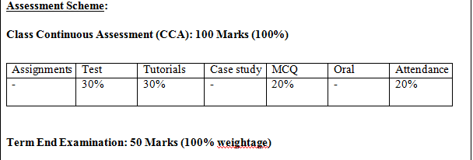
Assessment Scheme * change now

Slide 6
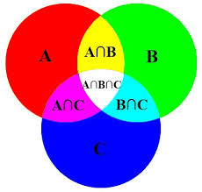
Set Theory
UNIT I

Slide 7
Definition
A set is a structure, representing an unordered collection (group, plurality) of zero or more distinct (different) objects.

Slide 8
Sets
A set is an unordered collection of objects.
the students in this class
the chairs in this room
The objects in a set are called the elements, or members of the set. A set is said to contain its elements.
Set theory deals with operations between, relations among, and statements about sets.

Slide 9
Symbols
∈: Used to replace the words “is an element of.”
∉: Used to replace the words “is not an element of.”
True or False:
3 ∈ {1, 2, 5, 9, 13}
False
0 ∈ {0, 1, 2, 3}
True
-5 ∉ {5, 10, 15}
True

Slide 10
Describing a Set: Roster Method
S = {a,b,c,d}
Order not important
S = {a,b,c,d} = {b,c,a,d}
Each distinct object is either a member or not; listing more than once does not change the set.
S = {a,b,c,d} = {a,b,c,b,c,d}
Ellipses (…) may be used to describe a set without listing all of the members when the pattern is clear.
S = {a,b,c,d, ……,z }

Slide 11
Descriptive : Roster Method
Set of all vowels in the English alphabet:
V = {a,e,i,o,u}
Set of all odd positive integers less than 10:
O = {1,3,5,7,9}
Set of all positive integers less than 100:
S = {1,2,3,……..,99}
Set of all integers less than 0:
S = {…., -3,-2,-1}

Slide 12
Set-Builder Notation
Specify the property or properties that all members must satisfy:
S = {x | x is a positive integer less than 100}
S= {1,2,3,…,99}
O = {x | x is an odd positive integer less than 10}
O = {1,3,5,7,9}
O = {x ∈ Z⁺ | x is odd and x < 10}

Slide 13
Set-Builder Notation
A predicate may be used:
S = {x | P(x)}
Example: S = {x | Prime(x)}
Positive rational numbers:
Q⁺ = {x ∈ R | x = p/q, for some positive integers p,q}

Slide 14
Finite and Infinite Sets
Finite set: The number of elements in a set are countable.
Infinite set: The number of elements in a set are not countable
{2, 4, 8, 16}
Finite set
{1, 2, 3, …}
Infinite set

Slide 15
Some Important Sets
N = natural numbers = {0,1,2,3….}
Z = integers = {…,-3,-2,-1,0,1,2,3,…}
Z⁺ = positive integers = {1,2,3,…..}
R = set of real numbers
R⁺ = set of positive real numbers
C = set of complex numbers.
Q = set of rational numbers

Slide 16
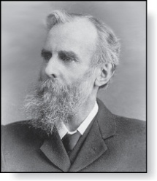
Universal Set
The universal set U is the set containing everything currently under consideration.
Sometimes implicit
Sometimes explicitly stated.
Contents depend on the context.
Venn Diagram
U
a e i o u
V
John Venn (1834-1923)
Cambridge, UK

Slide 17
Definition
Universal set: the set that contains every object of interest in the universe.
Complement of a Set: A set of objects of the universal set that are not an element of a set inside the universal set. Notation: A′
Venn Diagram: A rectangle represents the universal set and circles represent sets of interest within the universal set
A′
A
U

Slide 18
Definition: Empty Set
Empty Set: A set that contains no elements. It is also known as the Null Set. The symbol is ∅
The set of integer numbers between six and thirteen.
{7, 8, 9, 10, 11, 12}
BUT
{x | x is an integer number between 6 and 7}
∅
Empty set
Null set
{ }

Slide 19
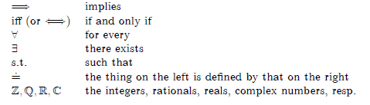
Common Notations Used

Slide 20
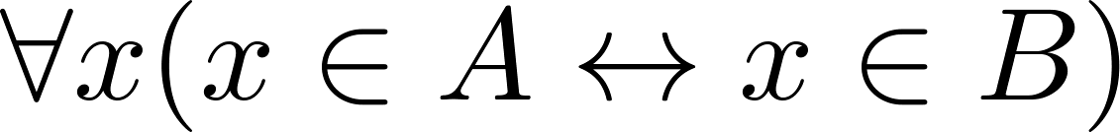
Set Equality
Definition: Two sets are equal if and only if they have the same elements.
Therefore if A and B are sets, then A and B are equal if and only if .
We write A = B if A and B are equal sets.
{1,3,5} = {3, 5, 1}
{1,5,5,5,3,3,1} = {1,3,5}

Slide 21
Equality of Sets
Set A is equal to set B if the following conditions are met:
1. Every element of A is an element of B.
2. Every element of B is an element of A.
Are the following sets equal?
{–4, 3, 2, 5} and {–4, 0, 3, 2, 5}
Not equal
{3} and {x | x is a counting number between 2 and 5}
Not equal
{11, 12, 13,…} and {x | x is a natural number greater than 10}
Equal

Slide 22
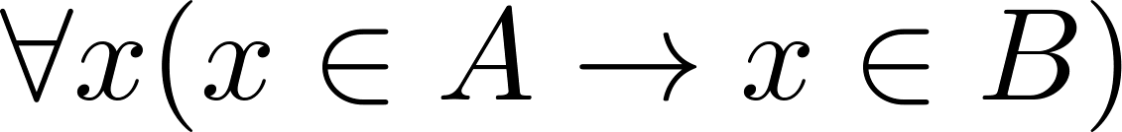
Subsets
Definition: The set A is a subset of B, if and only if every element of A is also an element of B.
The notation A ⊆ B is used to indicate that A is a subset of the set B.
A ⊆ B holds if and only if is true.
∅ ⊆ S for every set S.
S ⊆ S for every set S.

Slide 23
Notations used in Subsets
Showing that A is a Subset of B: To show that A ⊆ B, show that if x belongs to A, then x also belongs to B.
A ⊇ B means “A is a superset of B.”
Showing that A is not a Subset of B: To show that A is not a subset of B, A ⊈ B, find an element x ∈ A with x ∉ B.
(Such an x is a counterexample to the claim that x ∈ A implies x ∈ B.)
Examples:
The set of all computer science majors at your school is a subset of all students at your school.
The set of integers with squares less than 100 is not a subset of the set of nonnegative integers.

Slide 24
Example: Subsets
Subset of a Set: Set A is a Subset of B if every element of A is an element of B. Notation: A⊆B
Subset or not?
⊆
{3, 4, 5, 6} {3, 4, 5, 6, 8}
⊆
{1, 2, 6} {2, 4, 6, 8}
⊆
{5, 6, 7, 8} {5, 6, 7, 8}
B⊆B
Note: Every set is a subset of itself.

Slide 25
Definition of Subsets in-terms of Set Equality
Set Equality: Given A and B are sets, then A = B if A⊆B and B⊆A.
=
{1, 2, 6} {1, 2, 6}
≠
{5, 6, 7, 8} {5, 6, 7, 8, 9}

Slide 26
Definition of Subsets in-terms of Set Equality
Recall that two sets A and B are equal, denoted by A = B, iff
Using logical equivalences we have that A = B iff
This is equivalent to
A ⊆ B and B ⊆ A

Slide 27
Proper Subsets
Definition: If A ⊆ B, but A ≠B, then we say A is a proper subset of B, denoted by A ⊂ B. If A ⊂ B, then
is true.
Venn Diagram
U
B
A

Slide 28
Examples
Proper Subset of a Set: Set A is a proper subset of Set B if A⊆B and A ≠ B. Notation A⊂B
What makes the following statements true?
⊂, ⊆, or both
both
{3, 4, 5, 6} {3, 4, 5, 6, 8}
both
{1, 2, 6} {1, 2, 4, 6, 8}
⊆
{5, 6, 7, 8} {5, 6, 7, 8}
The empty set (∅) is a subset and a proper subset of every set except itself.

Slide 29
Example :Proper Subset
B = {0,1,2,3,4,5,6,7,8,9} Decimal digits
A = {2,4,6,8} Even decimal digits
C= {2,4,6,8}
Is A ⊂ B ?
Yes
Is A ⊂ C ?
No

Slide 30
Number of Subsets and Proper Subsets
The number of subsets of a set with n elements is: 2^{n}
Number of Proper Subsets
The number of proper subsets of a set with n elements is: 2^{n} – 1
List the subsets and proper subsets of
{1, 2}
Subsets:
{1}
{2}
{1,2}
∅
2² = 4
Proper subsets:
{1}
{2}
∅
2² – 1= 3

Slide 31
List the subsets and proper subsets of
{a, b, c}
Subsets:
{a}
{b}
{c}
{a, b}
{a, c}
{b, c}
2³ = 8
{a, b, c}
∅
Proper subsets:
{a}
{b}
{c}
{a, b}
{a, c}
{b, c}
2³ – 1 = 7
∅

Slide 32
Power Sets
Definition: The set of all subsets of a set A, denoted P(A), is called the power set of A.
Example: If A = {a,b} then
P(A) = {ø, {a},{b},{a,b}}
If a set has n elements, then the cardinality of the power set is 2ⁿ.

Slide 33
Examples : Power sets
If S is a set, then the power set of S is
2^{S} = { x : x ⊆ S }.
aka P(S)
If S = {a},
We say, “P(S) is the set of all subsets of S.”
2^{S} = {∅, {a}}.
If S = {a,b},
2^{S} = {∅, {a}, {b}, {a,b}}.
If S = ∅,
2^{S} = {∅}.
If S = {∅,{∅}},
2^{S} = {∅, {∅}, {{∅}}, {∅,{∅}}}.
Fact: if S is finite, |2^{S}| = 2^{|S|}. (if |S| = n, |2^{S}| = 2^{n})

Slide 34
Disjointedness
Two sets A, B are called disjoint (i.e., unjoined) iff their intersection is empty. (A∩B=∅)
Example: the set of even integers is disjoint with the set of odd integers.
Help, I’ve been disjointed!

Slide 35
Set Cardinality
Definition: If there are exactly n distinct elements in S where n is a nonnegative integer, we say that S is finite. Otherwise it is infinite.
Definition: The cardinality of a finite set A, denoted by |A|, is the number of (distinct) elements of A.
Examples:
|ø| = 0
Let S be the letters of the English alphabet. Then |S| = 26
|{1,2,3}| = 3
|{ø}| = 1
The set of integers is infinite.

Slide 36
Cardinality and Finiteness
|S| (read “the cardinality of S”) is a measure of how many different elements S has.
E.g., |∅|=0, |{1,2,3}| = 3, |{a,b}| = 2,
|{{1,2,3},{4,5}}| = 2
We say S is infinite if it is not finite.
What are some infinite sets we’ve seen?
N,Z,R

Slide 37
Cardinality
If S is finite, then the cardinality of S, |S|, is the number of distinct elements in S.
|S| = 3.
If S = {1,2,3},
If S = {3,3,3,3,3},
|S| = 1.
If S = ∅,
|S| = 0.
|S| = 3.
If S = { ∅, {∅}, {∅,{∅}} },
If S = {0,1,2,3,…}, |S| is infinite.

Slide 38
Multisets
Two ordinary sets are identical if they have the same elements, so for instance, {a, a, b} and {a, b} are the same set because they have exactly the same elements, namely a and b.
However, in some applications it might be useful to allow repeated elements in a set.

Slide 39
Contd.
In that case we use multisets, which are mathematical entities similar to sets, but with possibly repeated elements.
So, as multisets, {a, a, b} and {a, b} would be considered different, since in the first one the element a occurs twice and in the second one it occurs only once.

Slide 40
Multiplicity: Example
The set {a, b} contains only elements a and b, each having multiplicity 1, when {a, b} is seen as a multiset.
In multiset {a, a, b}, the element a has multiplicity 2, and b has multiplicity 1.
In multiset {a, a, a, b, b, b}, a and b both have multiplicity 3.

Slide 41
Contd.
One of the simplest and most natural examples is the multiset of prime factors of a number n. Here the underlying set of elements is the set of prime divisors of n. For example, the number 120 has the prime factorization
which gives the multiset {2, 2, 2, 3, 5}.

Slide 42
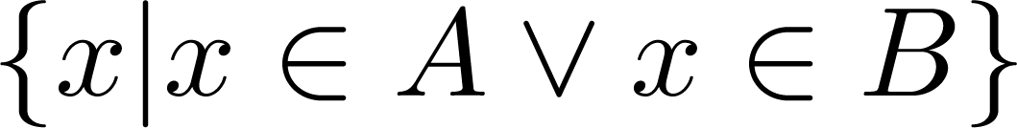
Set Operations: Union
Definition: Let A and B be sets. The union of the sets A and B, denoted by A ∪ B, is the set:
Example: What is {1,2,3} ∪ {3, 4, 5}?
Solution: {1,2,3,4,5}
Venn Diagram for A ∪ B
U
A
B

Slide 43
Union: Example
A ∪ B = {x | x ∈ A or x ∈ B}
{1, 2, 5, 9, 13} ∪ {2, 4, 6, 9}
{1, 2, 4, 5, 6, 9, 13}
{a, c, d, g} ∪ {l, m, n, o}
{a, c, d, g, l, m, n, o}
{4, 6, 7, 19, 23} ∪ {7, 8, 19, 20, 23, 24}
{4, 6, 7, 8, 19, 20, 23, 24}

Slide 44
Generalized Union
Binary union operator: A∪B
n-ary union: A₁ ∪A₂∪…∪A_{n} :≡ ((…((A₁∪ A₂) ∪…)∪ A_{n}) (grouping & order is irrelevant)
“Big U” notation:
Or for infinite sets of sets:

Slide 45
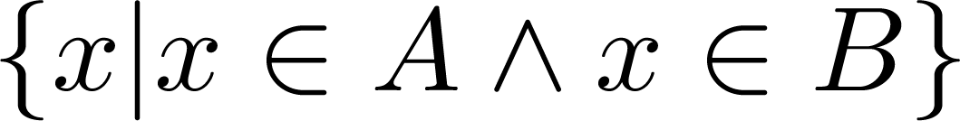
Set Operations: Intersection
Definition: The intersection of sets A and B, denoted by A ∩ B, is
Note if the intersection is empty, then A and B are said to be disjoint.
Example: What is {1,2,3} ∩ {3,4,5} ?
Solution: {3}
Example:What is
{1,2,3} ∩ {4,5,6} ?
Solution: ∅
Venn Diagram for A ∩B
U
A
B

Slide 46
Intersection: Example
A ∩ B = {x | x ∈ A and x ∈ B}
{1, 2, 5, 9, 13} ∩ {2, 4, 6, 9}
{2, 9}
{a, c, d, g} ∩ {l, m, n, o}
∅
{4, 6, 7, 19, 23} ∩ {7, 8, 19, 20, 23, 24}
{7, 19, 23}

Slide 47
Generalized Intersection
Binary intersection operator: A∩B
n-ary intersection: A₁ ∩A₂∩…∩A_{n}≡((…((A₁∩A₂)∩…)∩A_{n}) (grouping & order is irrelevant)
“Big Arch” notation:
Or for infinite sets of sets:

Slide 48
Set Operations: Complement
Definition: If A is a set, then the complement of the A (with respect to U), denoted by Ā is the set U - A
Ā = {x ∈ U | x ∉ A}
(The complement of A is sometimes denoted by A^{c} .)
Example: If U is the positive integers less than 100, what is the complement of {x | x > 70}
Solution: {x | x ≤ 70}
Venn Diagram for Complement
U
Ā
A

Slide 49
Set Operations: Difference
Definition: Let A and B be sets. The difference of A and B, denoted by A – B, is the set containing the elements of A that are not in B. The difference of A and B is also called the complement of B with respect to A.
A – B = {x | x ∈ A ∧ x ∉ B} = A ∩‾B
U
Venn Diagram for A − B
A
B

Slide 50
Set Difference - Venn Diagram
A-B is what’s left after B “takes a bite out of A”
Chomp!
Set A−B
Set A
Set B

Slide 51
Set Difference : Example
A – B = {x | x ∈ A and x ∉ B}
U = {1, 2, 3, 4, 5, 6, 7}
A = {1, 2, 3, 4, 5, 6} B = {2, 3, 6} C = {3, 5, 7}
A′ = {7}
B′ = {1, 4, 5, 7}
C′ = {1, 2, 4, 6}
Find each set.
A – B
{1, 4, 5}
B – A
∅
Note: A – B ≠ B – A
(A – B) ∪ C′
{1, 2, 4, 5, 6, }

Slide 52
Set Difference Examples
{1,2,3,4,5,6} − {2,3,5,7,9,11} =
___________
Z − N = {… , -1, 0, 1, 2, … } − {0, 1, … } = {x | x is an integer but not a natural} = {x | x is a negative integer} = {… , -3, -2, -1}
{1,4,6}

Slide 53


Set Operations: Symmetric Difference
Definition: The symmetric difference of A and B, denoted by is the set
Example:
U = {0,1,2,3,4,5,6,7,8,9,10}
A = {1,2,3,4,5} B ={4,5,6,7,8}
What is :
Solution: A-B={1,2,3}
B-A={6,7,8}
={1,2,3,6,7,8}
U
A
B
Venn Diagram

Slide 54
The Cardinality of the Union of Two Sets: Inclusion-Exclusion Principle
Inclusion-Exclusion
|A ∪ B| = |A| + | B| − |A ∩ B|
Example: Let A be the math majors in your class and B be the CS majors. To count the number of students who are either math majors or CS majors, add the number of math majors and the number of CS majors, and subtract the number of joint CS/math majors.
U
A
B
Venn Diagram for A, B, A ∩ B, A ∪ B

Slide 55
Principle of Inclusion-Exclusion : Example
Example:
There are 217 CS majors.
157 are taking IoT.
145 are taking AI.
98 are taking both.
How many are taking neither?
157
145
217 - (157 + 145 - 98) = 13

Slide 56
Principle of Inclusion-Exclusion : Example
For any two sets A and B,
Find n(A) if n(A∪B) = 78, n(A∩B) = 21, and n(B) = 36.
n(A∪B) = n(A) + n(B ) – n(A∩B)
78 = n(A) + 36 – 21
78 = n(A) + 15
63 = n(A)

Slide 57
Shading Venn Diagrams: More Practice Example
A′ ∩ B
A
B
U
A′
A
B
A
B
U
U
A′ ∩ B in yellow

Slide 58
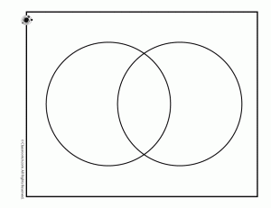
Locating Elements in a Venn Diagram : More Practice Example
U = {1, 2, 3, 4, 5, 6, 7, 8, 9, 10}
A = {2, 3, 4, 5, 6}
B = {4, 6, 8}
1
7
A
B
Start with A ∩ B
2
4
3
8
Fill in each subset of U.
6
5
Fill in remaining elements of U.
U
9
10

Slide 59
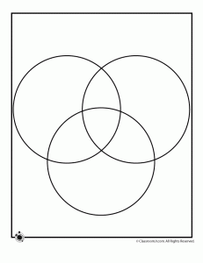
Shade a Venn diagram for the given statement: More practice Example
(A′ ∩ B′) ∩ C
Work with the parentheses.
(A′ ∩ B′)
A
B
C
U

Slide 60
Shade a Venn diagram for the given statement.
(A′ ∩ B′) ∩ C
Work with the parentheses.
(A′ ∩ B′)
Work with the remaining part of the statement.
A
B
(A′ ∩ B′) ∩ C
C
U

Slide 61
Shade a Venn diagram for the given statement.
(A′ ∩ B′) ∩ C
Work with the parentheses.
(A′ ∩ B′)
Work with the remaining part of the statement.
A
B
(A′ ∩ B′) ∩ C
C
U

Slide 62
Surveys and Venn Diagrams
Financial Aid Survey of a Small College (100 sophomores).
49 received Government grants
55 received Private scholarships
43 received College aid
G
P
23 received Gov. grants & Pri. scholar.
16
15
12
18 received Gov. grants & College aid
8
28 received Pri. scholar. & College aid
20
10
8 received funds from all three
(P∩C) – (G∩P∩C) 28 – 8 = 20
5
43 – (10 + 8 +20) = 5
C
(G∩C) – (G∩P∩C) 18 – 8 = 10
U
14
55 – (15 + 8 + 20) = 12
(G∩P) – (G∩P∩C) 23 – 8 = 15
49 – (15 + 8 + 10) = 16
100 – (16+15 + 8 + 10+12+20+5) = 14

Slide 63



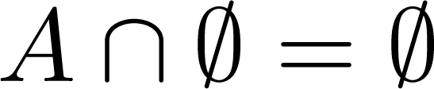


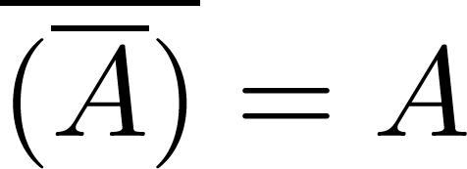
Set Identities(1)
Identity laws
Domination laws
Idempotent laws
Complementation law

Slide 64


Set Identities(2)
Commutative laws
Associative laws
Distributive laws

Slide 65


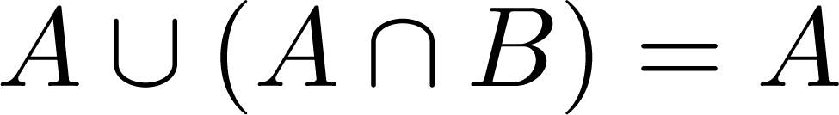
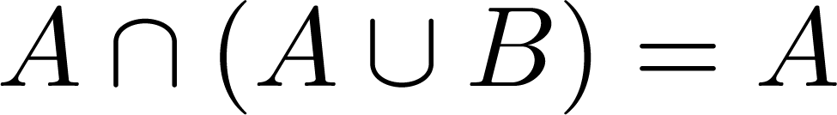

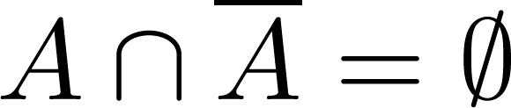
Set Identities(3)
De Morgan’s laws
Absorption laws
Complement laws

Slide 66
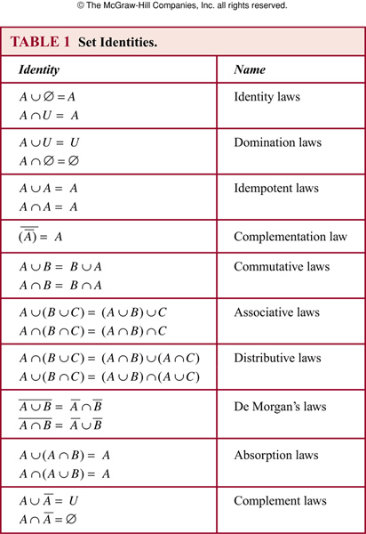

Slide 67
Proving Set Identities
Different ways to prove set identities:
Prove that each set (side of the identity) is a subset of the other.
Use set builder notation and propositional logic.
Membership Tables: Verify that elements in the same combination of sets always either belong or do not belong to the same side of the identity. Use 1 to indicate it is in the set and a 0 to indicate that it is not.

Slide 68





Example: Membership Table
Construct a membership table to show that the distributive law holds.
Example:
Solution:
A | B | C
1 | 1 | 1 | 1 | 1 | 1 | 1 | 1
1 | 1 | 0 | 0 | 1 | 1 | 1 | 1
1 | 0 | 1 | 0 | 1 | 1 | 1 | 1
1 | 0 | 0 | 0 | 1 | 1 | 1 | 1
0 | 1 | 1 | 1 | 1 | 1 | 1 | 1
0 | 1 | 0 | 0 | 0 | 1 | 0 | 0
0 | 0 | 1 | 0 | 0 | 0 | 1 | 0
0 | 0 | 0 | 0 | 0 | 0 | 0 | 0

Slide 69
Tuples
The ordered n-tuple (a₁,a₂,…..,a_{n}) is the ordered collection that has a₁ as its first element and a₂ as its second element and so on until a_{n} as its last element.
Two n-tuples are equal if and only if their corresponding elements are equal.
These are like sets, except that duplicates matter, and the order makes a difference.
Note (1, 2) ≠ (2, 1) ≠ (2, 1, 1).
Ordered Pairs: in the ordered pair (a, b), a is the first component and b is the second component. In general, (a, b) ≠ (b, a)
The ordered pairs (a,b) and (c,d) are equal if and only if a = c and b = d.

Slide 70
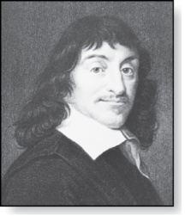
Cartesian Product
René Descartes (1596-1650)
Definition: The Cartesian Product of two sets A and B, denoted by A × B is the set of ordered pairs (a,b) where a ∈ A and b ∈ B .
Example:
A = {a,b} B = {1,2,3}
A × B = {(a,1),(a,2),(a,3), (b,1),(b,2),(b,3)}
Definition: A subset R of the Cartesian product A × B is called a relation from the set A to the set B.

Slide 71
Cartesian Product of Sets: Given sets A and B, the Cartesian product represents the set of all ordered pairs from the elements of both sets.
A × B = {(a, b) | a ∈ A and b ∈ B}
Find each set.
A = {1, 5, 9}
B = {6,7}
A × B
{
(1, 6),
(1, 7),
(5, 6),
(5, 7),
(9, 6),
(9, 7)
}
B × A
{
(6, 1),
(6, 5),
(6, 9),
(7, 1),
(7, 5),
(7, 9)
}

Slide 72
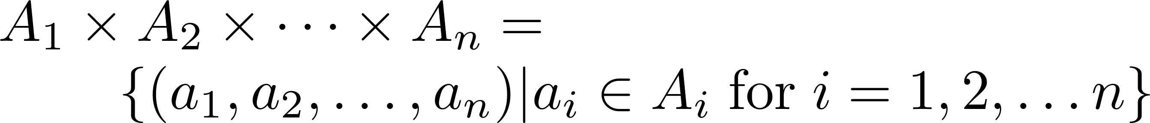
Generalized Cartesian Product
Definition: The cartesian products of the sets A₁,A₂,……,A_{n}, denoted by A₁ × A₂ × …… × A_{n} , is the set of ordered n-tuples (a₁,a₂,……,a_{n}) where a_{i} belongs to A_{i} for i = 1, … n.
Example: What is A × B × C where A = {0,1}, B = {1,2} and
C = {0,1,2}
Solution: A × B × C = {(0,1,0), (0,1,1), (0,1,2),(0,2,0), (0,2,1), (0,2,2),(1,1,0), (1,1,1), (1,1,2), (1,2,0), (1,2,1), (1,2,2)}

Slide 73
Georg Cantor 1845 – 1918
Countable & Uncountable infinite sets
One-to-one correspondence
Countable
Uncountable
Infinite number of infinite sets of different sizes

Slide 74
One-to-one correspondence
Two sets M and N are equivalent … if it is possible to put them, by some law, in such a relation to one another that to every element of each one of them corresponds one and only one element of the other.
If M and N are equivalent we often say that they have they have the same cardinality or the same power
If M and N are finite this means they have the same number of elements
But what about the case when M and N are infinite?

Slide 75
Countable infinite set
N = {1, 2, 3, …} the set of natural numbers
E = {2, 4, 6, …} the set of even natural numbers
A set is infinite if it can be put into one-to-one correspondence with a proper subset of itself.
A proper subset does not contain all the elements of the set.

Slide 76
Fact
A countable set is either a finite set or a countably infinite set.
Whether finite or infinite, the elements of a countable set can always be counted one at a time and, although the counting may never finish, every element of the set is associated with a unique natural number.

Slide 77
Countable infinite examples
N = {1, 2, 3, …} the set of natural numbers
E = {2, 4, 6, …} the set of even natural numbers
Z = {… -3, -2, -1, 0, 1, 2, 3, …} the set of all integers

Slide 78
Any set that could be put into one-to-one correspondence with N is called countably infinite or denumerable
Countably Infinite or Denumerable
The symbol used to denote the size of a countable set is ℵ₀ which is read as aleph-nought or aleph-null.
It is named after the first letter of the Hebrew alphabet.
Cardinality of E = cardinality of Z = cardinality of N = ℵ₀

Slide 79
Rational numbers are Countable
A rational number or fraction is any integer divided by any nonzero integer, for example, 5/4, 87/32, -567/981.
The rational numbers don’t have gaps in the sense that between any two rational numbers there is another rational
The rational numbers are countable

Slide 80
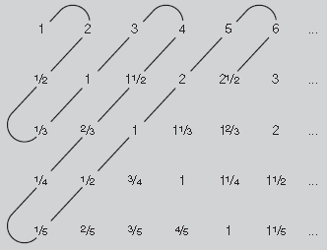
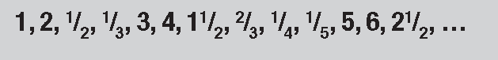
Rational numbers are Countable
the first row lists the integers,
the second row lists the ‘halves’, the third row the thirds the fourth row the quarters and so on.
We then ‘snake around’ the diagonals of this array of numbers, deleting any numbers that we have seen before: this gives the list
This list contains all the positive fractions, so the positive fractions are countable.

Slide 81
Rational Numbers are countable
The rational numbers can be thought of as precisely the collection of decimals which terminate or repeat
Example::
5/4=1.25000000...... 17/7=2.428571428571428571......
-133/990 = - 0.134343434…
The decimal expansion of a fraction must terminate or repeat because when you divide the bottom integer into the top one there are only a limited number of remainders you can get.

Slide 82
Rational Numbers are countable
A repeating decimal is a fraction e.g.
Consider x = 0.123123123123 …
This has a repeating block of length 3
Multiply by 10³ to get
1000 x = 123.123123123 …
Subtract x
x = 0.123123123 …999x = 123
x = 123/999 = 41/333
The irrationals are those real numbers which are not rational
So their decimal expansions do not terminate or repeat

Slide 83
The Real numbers are Uncountable
The set of real numbers in the interval from 0 up to 1 is not countable. Suppose they are countable then we can create a list like
1 ↔ x₁ = 0.256173…
2 ↔ x₂ = 0.654321…
3 ↔ x₃ = 0.876241…
4 ↔ x₄ = 0.60000….
. . . .
n ↔ x_{n} = 0.a₁a₂a₃a₄a₅ …a_{n} …
The a1,a2... an can be completely random : non repetitive. So uncountable.

Slide 84
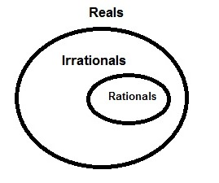
Cardinality of important sets
Set | Description | Cardinality
Natural numbers | 1, 2, 3, 4, 5, … | ℵ₀
Integers | …, -5, -4, -3, -2, -1, 0, 1, 2, 3, 4, 5, … | ℵ₀
Rational numbers or fractions | All the decimals which terminate or repeat | ℵ₀
Irrational numbers | All the decimals which do not terminate or repeat | c
Real numbers | All decimals | c

